Slide 1
Quantum Computing Architectures (EE274) Lecture 18
Hiu-Yung Wong
mar. 27, 2025
hiuyung.wong@sjsu.edu, Office: ENG363
http://www.sjsu.edu/people/hiuyung.wong/index.html

Slide 2
Outline
Quantization of SHO

Slide 3
Announcement
I have posted project part 1. Please check the due date and start working on it.

Slide 4
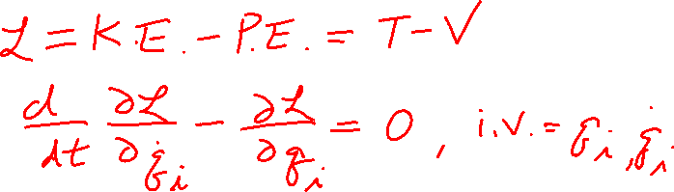
Lagrangian and Hamiltonian Mechanics
Chapter 13 of “Quantum Computing Architecture and Hardware for Engineers: Step by Step”

Slide 5
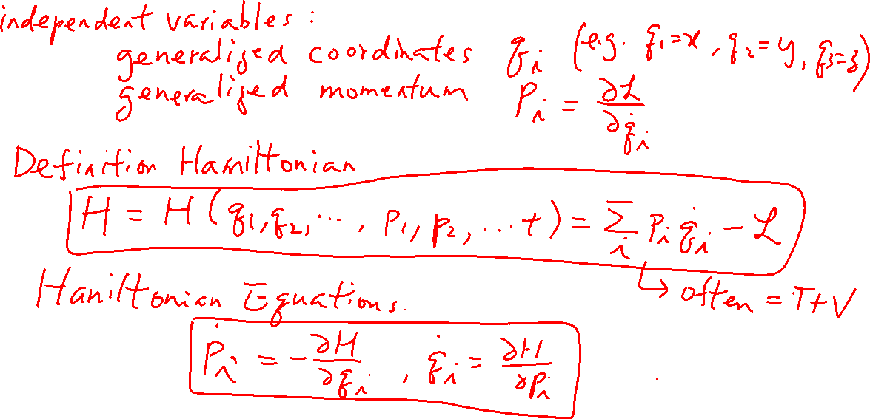
Hamiltonian Mechanics
From the last lecture
Learning outcomes: Understand the relationship between Lagrangian and Hamiltonian

Slide 6
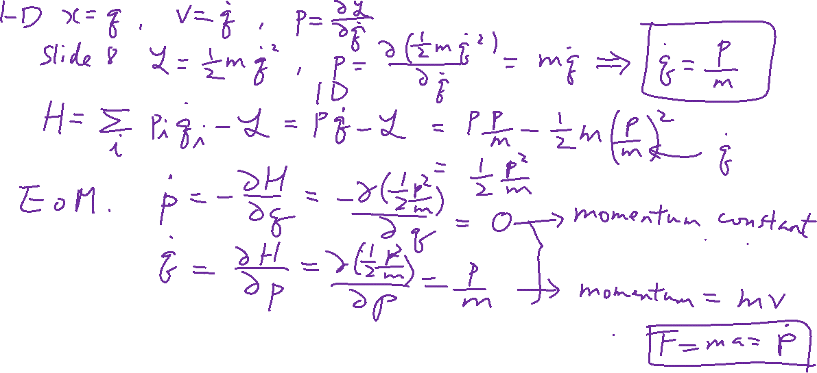

Example: Solving a Free Particle using Hamiltonian Mechanics
From the last lecture
Learning outcomes: Learn how to use Hamiltonian Equation

Slide 7
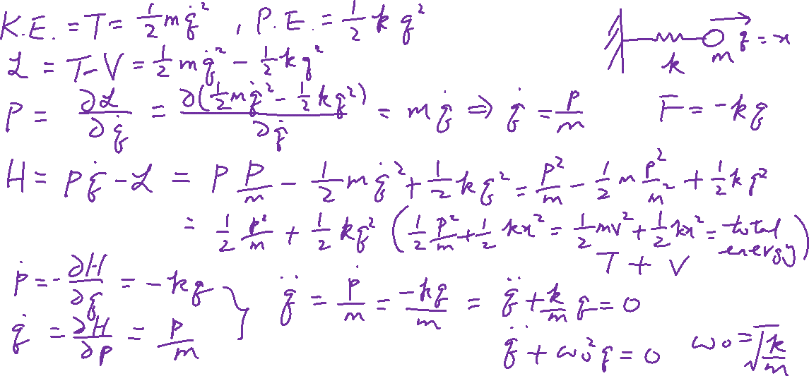
Example: Solving a Simple Harmonic Oscillator using Hamiltonian Mechanics
Learning outcomes: Appreciate the power of Hamiltonian and able to construct Hamiltonian from Lagrangian

Slide 8
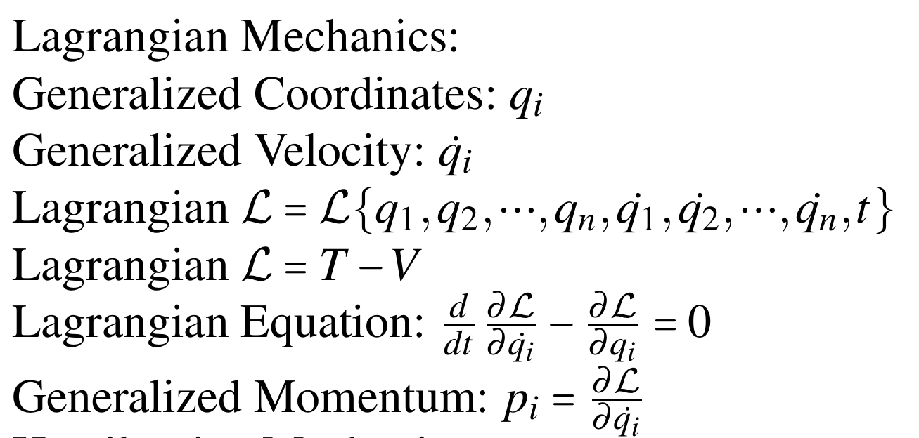
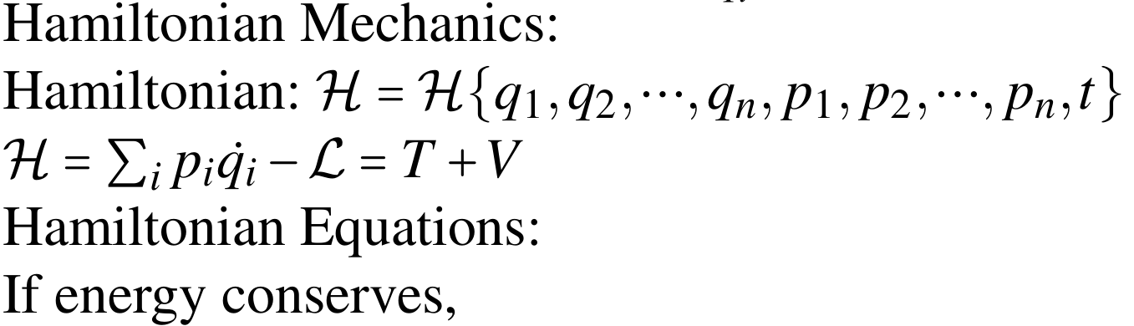
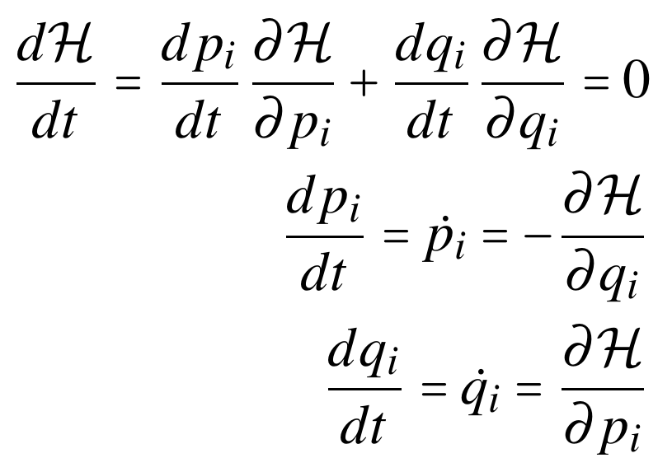
Summary of Lagrangian and Hamiltonian Mechanics

Slide 9
Quantization of SHO
Chapter 14 of “Quantum Computing Architecture and Hardware for Engineers: Step by Step”

Slide 10
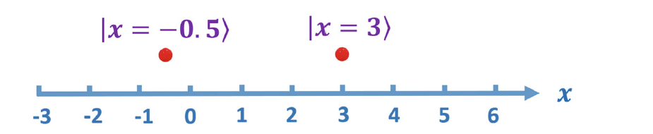
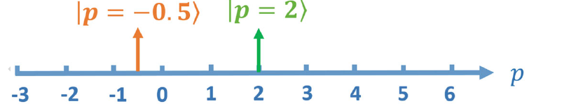
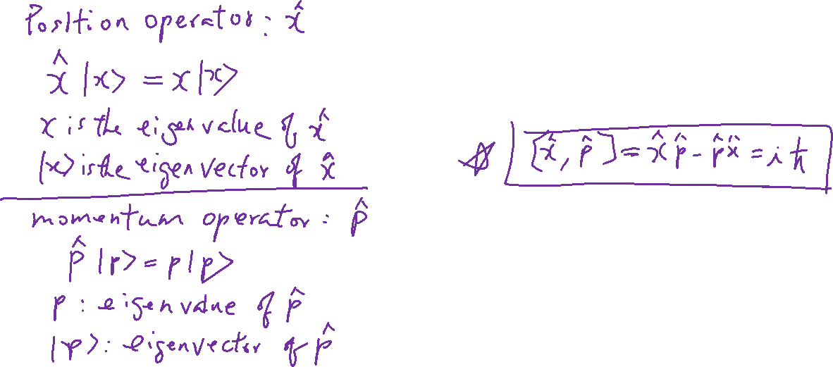
Position and Momentum Operators

Slide 11
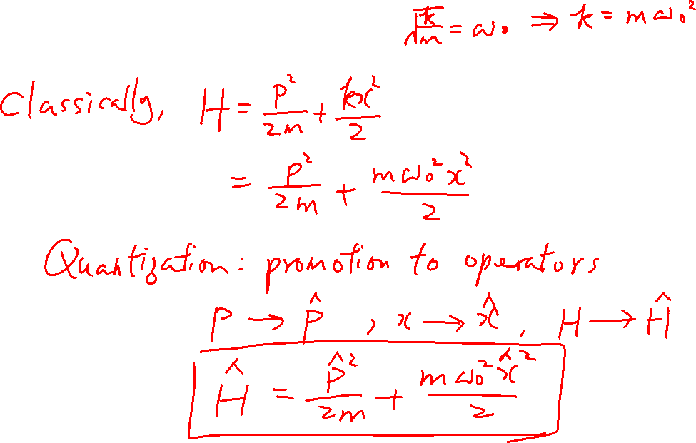
Quantization of SHO
Learning outcomes: Understand the math and Hamiltonian as a bridge between the classical and quantum mechanics.

Slide 12
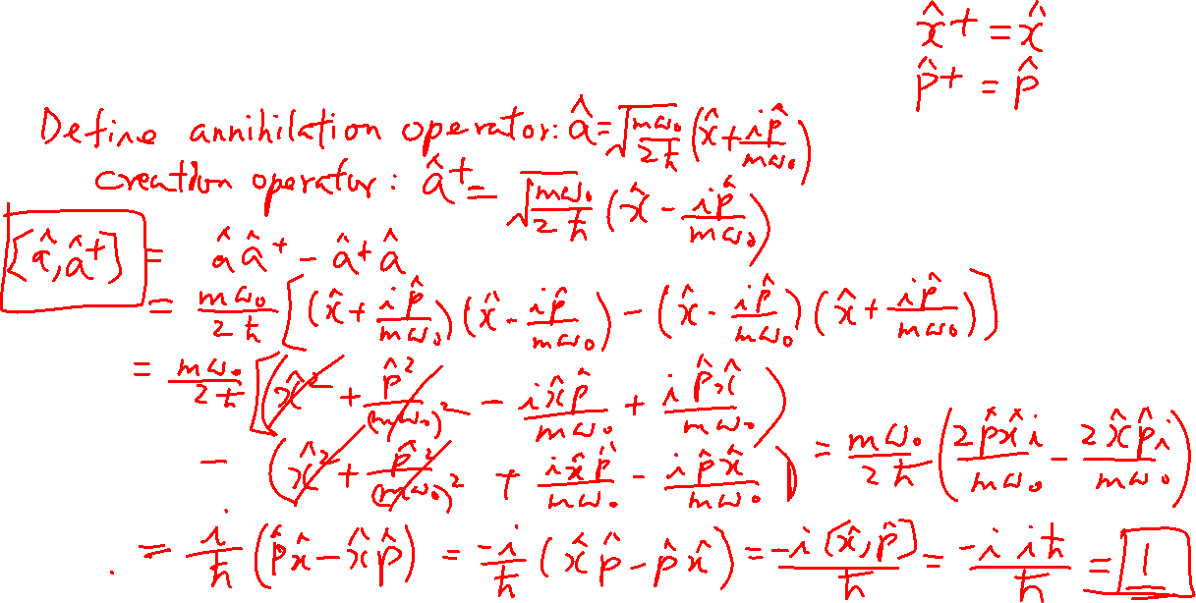
Creation and Annihilation Operators
Learning outcomes: Understand their relationship to x and p operators

Slide 13
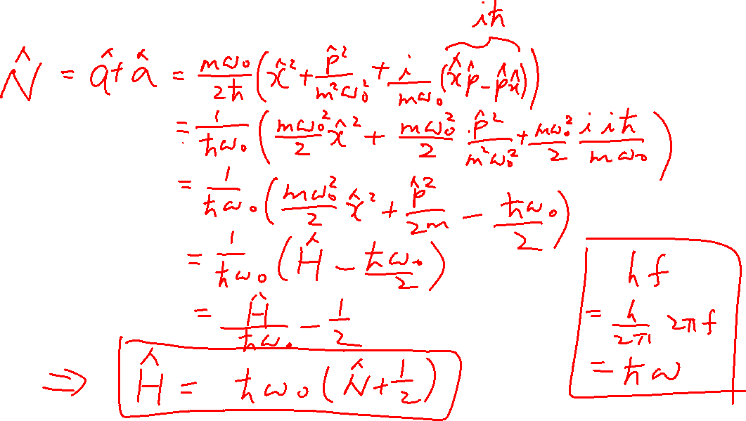
Number Operator
Learning outcomes: Understand its relationship to a and a⁺

Slide 14
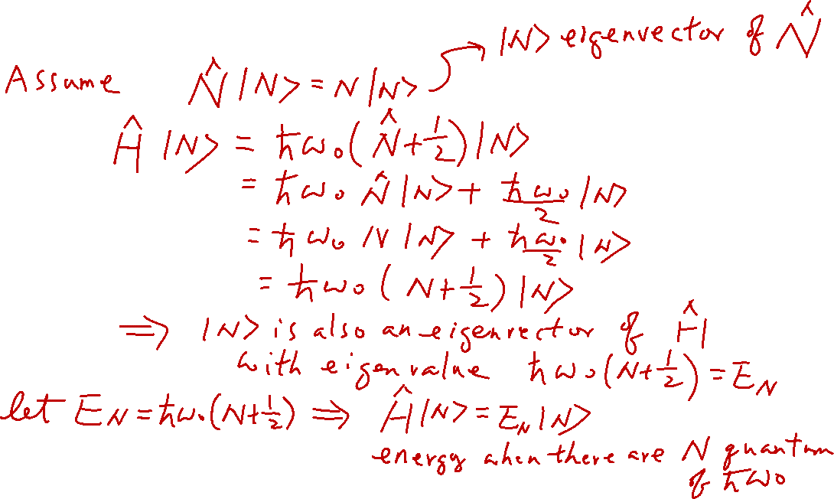
Number Operator
Learning outcomes: Understand its relationship to a and a⁺

